Slide 1
Transfer Coefficients 101
14.06.2023, Consortium Meeting, Berlin

Slide 2
Transfer coefficients
Just one part of the information we need to describe the processes
Transfer Coefficients represent the efficiency of recovery
Ratio that is transferred from one phase to the next.
They play a crucial role in determining success and profitability as higher transfer coefficients indicate less loss of valuable SRMs during the process.
What to measure:
Essential --> CRMs
Nice to have --> Elements that are 'strategic', hazardous, and commercially important

Slide 3
Transfer coefficients – aim and description
Aim: model and assess WS recovery
Link the composition data with the recovered quantities
Two perspectives
Distribution of flows
Transformation of flows (process efficiency)
P3
F1a.1
F0
F1a
P1
P2
F1a.2
F1b

Slide 4
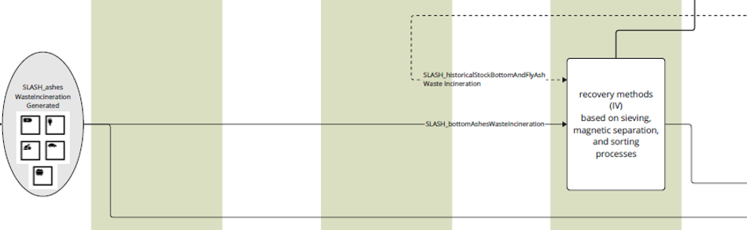
Bottom Ash Recovery example

Slide 5

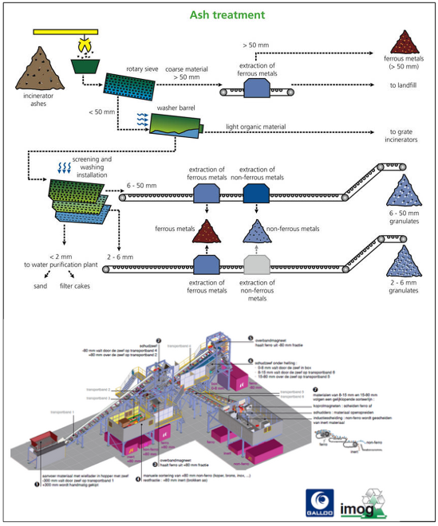

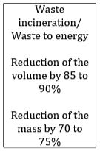
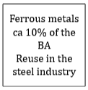
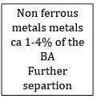
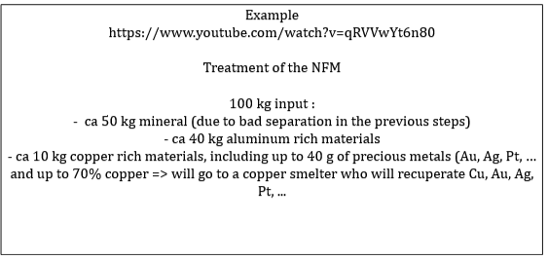
Bottom Ash Recovery example
NOT TRANSFER COEFFICIENTS !!!
WHY?
No information on input!!

Slide 6
Bottom Ash Recovery example
Bottom Ash Recovery Process
(BARP)
Mineral fraction
Al 0.8 kt
Ferrous metals
Al 0.1 kt
Bottom Ash
Al 10 kt
Very important!
Al TC for BARP from Bottom Ash
to Al rich fraction = 0.9
Al rich fraction
Al 9 kt
Cu rich fraction + Precious metals
Al 0.1 kt
What about the other outputs?
A: Nice to have, otherwise lost in process

Slide 7

Bottom Ash Recovery example
However, if CRM not currently
recovered
Bottom Ash Recovery Process
(BARP)
Mineral fraction
Ferrous metals
WHERE’s
W?
WHERE’s
Sc?
Bottom Ash
W 1 t
Al rich fraction
Cu rich fraction + Precious metals
Any of the 4 outputs or "lost"?
Important for future recovery
SLASH flows (from metallurgical process)
Rest/"lost"?

Slide 8
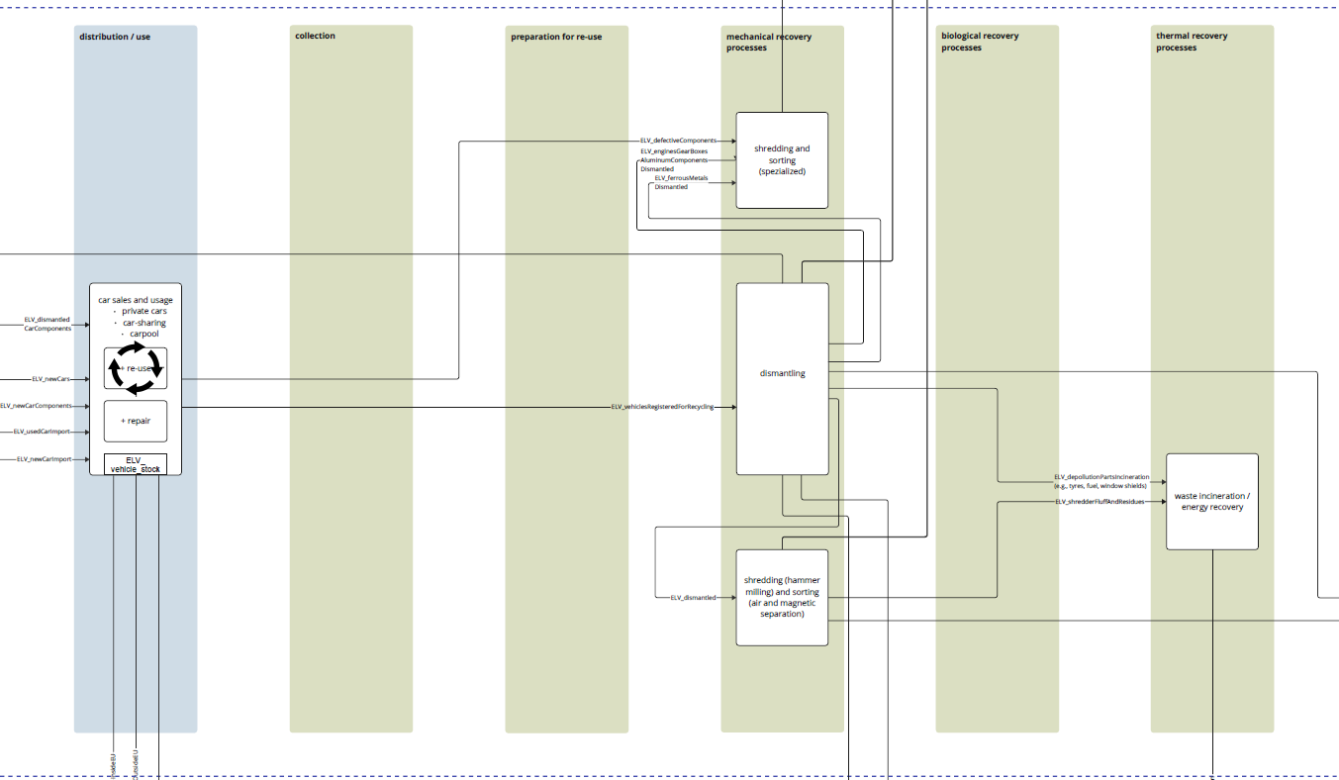
ELV example

Slide 9
ELV example
Shredding and sorting (specialized)
mechanicalRecoverySpecialized
AluminumComponents Dismantled
ferrousMetals Dismantled
TC = 0.9
Al rich fraction
Fe rich fraction
TC = 0.92
TC = 0.8
TC = 0.95
ELV_vehiclesRegisteredForRecycling
Product 1 ton
- Components
- Materials
Dismantling
SRM Dismantled
Component X & Y: TC = 1
WHERE’s
W?
Shredding (hammer milling) and sorting (air and magnetic separation
mechanicalRecovery
ELV Dismantled
Al rich fraction
Fe rich fraction
AluminumComponents Dismantled
ferrousMetals Dismantled
Rest Components/Materials
TC = 0.7
TC = 0.1
TC = 0.2
TC = 0.8
TC = 1

Slide 10
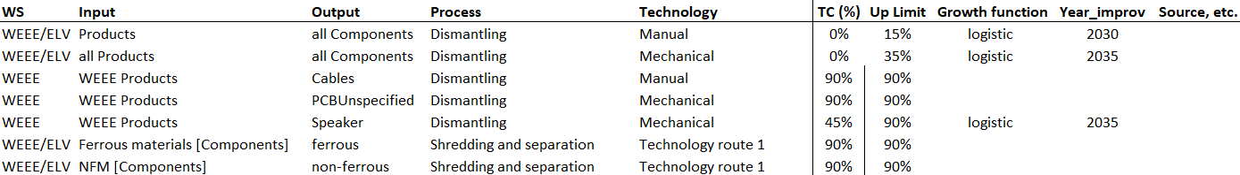
Data collection – transfer coefficients
Template for data collection is under development
European context
Harmonization of processes, products, components, materials list (avoid double work)
Scenarios: developing technologies, potential improvements

Slide 11
WS discussion
Potential sources for TC:
Industry data
Exploring possibility of conducting sampling/batch tests?
Literature
Databases (e.g., ecoinvent)
Where else?
Apart from CRMs, which other elements can we track?
More detailed description of the processes in the WS:
Consumption of energy, water, chemicals
Capital and operating costs
Etc...

